Slide 1
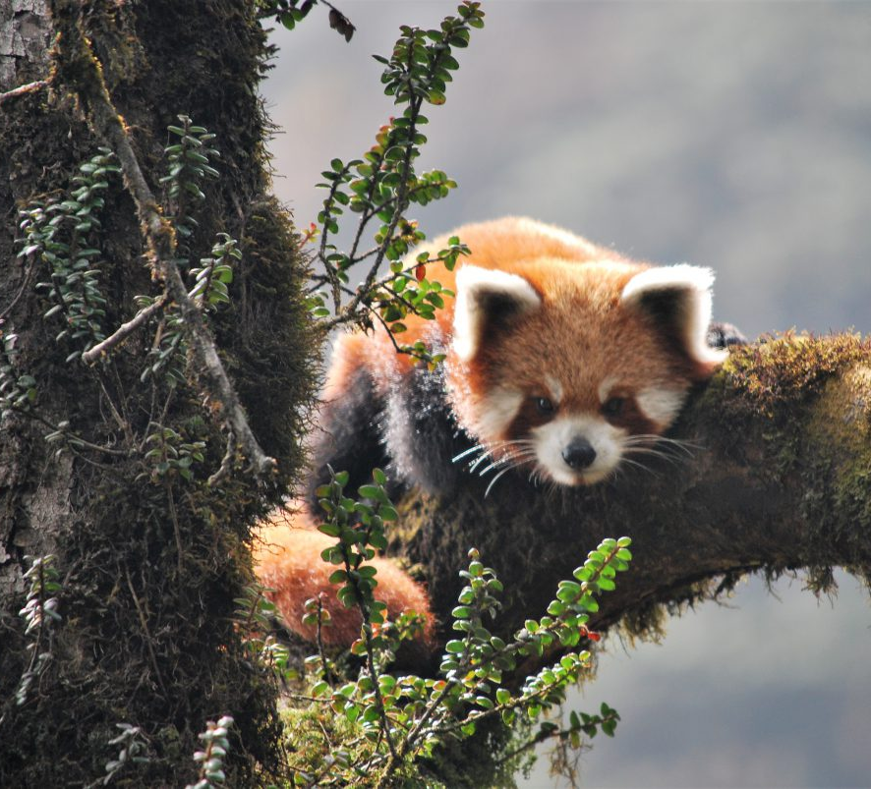
Where is forest being lost in red panda habitat?
Cameron Cosgrove
Photo Credit: Red Panda Network (CC)
Notes:
Title –results first? Then say mysterious thing

Slide 2
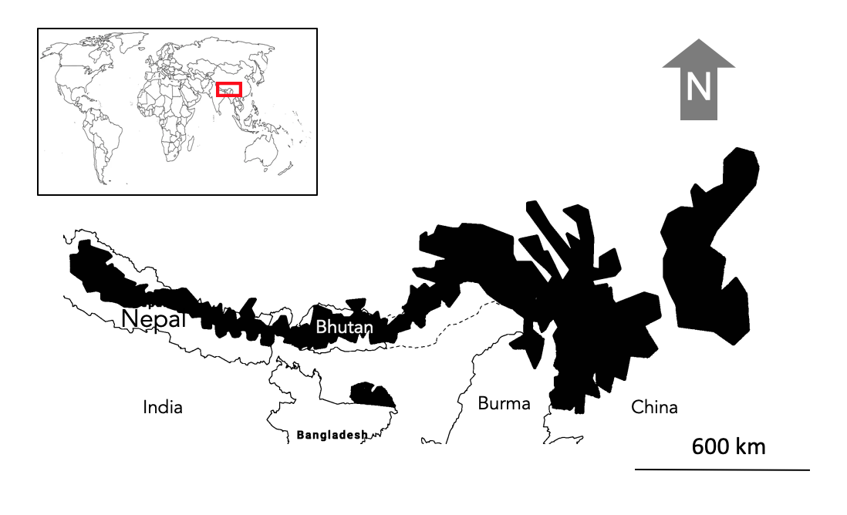
The red panda
Population decline of > 50% in the past three generations
Arboreal – niche specialist
High altitude species (1000 m – 5000 m)
Diet: 98% bamboo

Slide 3

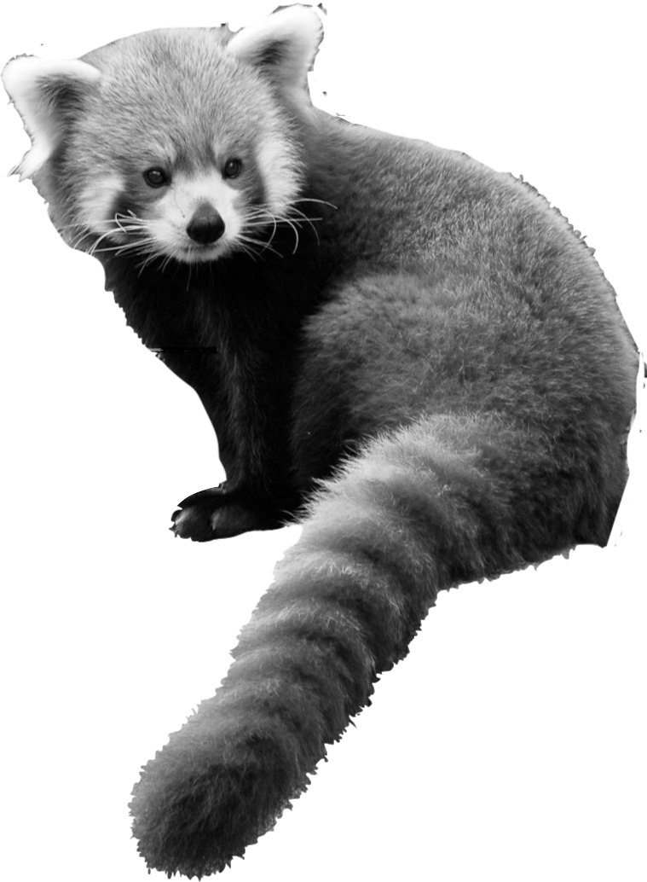

Main threats
Photo Credit: Cameron Cosgrove, Icons from the Noun Project (CC)

Slide 4
Knowledge gap
We don’t know what's going on across the entire range.
Are large areas of forest being lost?
How connected is the habitat throughout the range?
How many subpopulations are there?

Slide 5
Project objectives
RQ1: How much forest has been lost?
Conservation implications
RQ2: Where is loss occurring?
Notes:
Only now, with the high resolutions and MaxEnt distrubution

Slide 6

Methodology
Global Forest Change dataset
Measures forest at a 30 m resolution
Between 2000 – 2018
Limitations: cant detect small areas of loss but can show the broad spatial pattern of loss well
Analyze within red panda habitat
Google Earth Engine
A MaxEnt distribution defined habitat range
Quantify and map forest loss
Rough estimate of how much forest has been lost
Where are the hotspots of loss?
Are forests connected in panda habitat?
Are there any patterns in the location of loss?
Notes:
Predictions

Slide 7
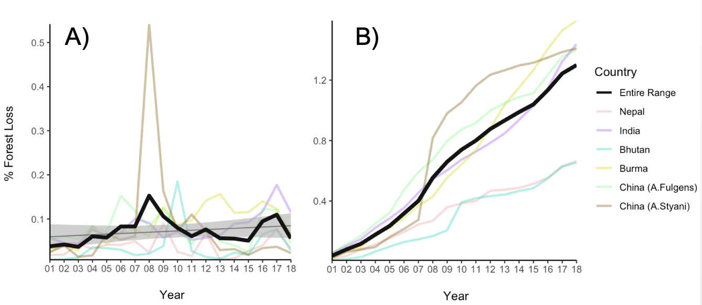
Only 1.3% of forest was lost across the entire range
Notes:
Total count
Talk about trends
Remove cross and make it a lable
Use animation
Make lines darker.
Add arrow to extreme and interesting points

Slide 8
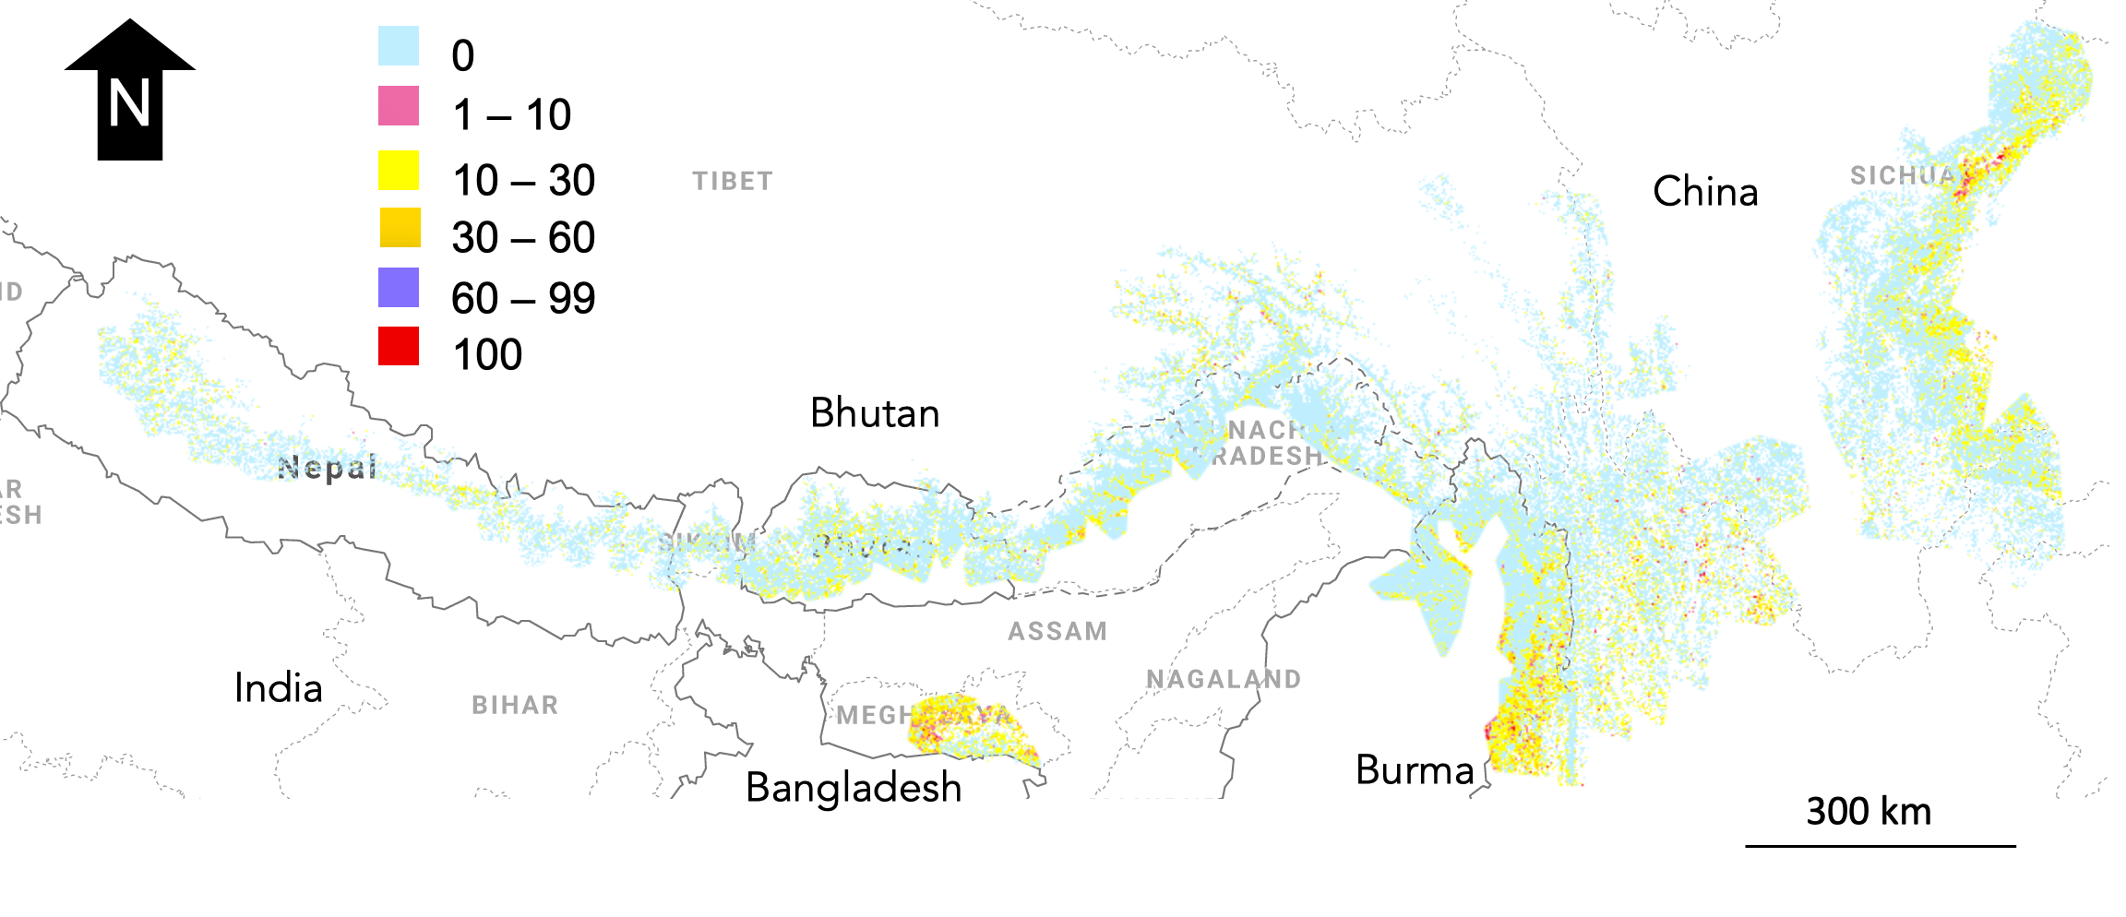
300 km
Notes:
Add zoom

Slide 9






20 km
0
1 – 10
10 – 30
30 – 60
60 – 99
100
Notes:
Core -> high

Slide 10
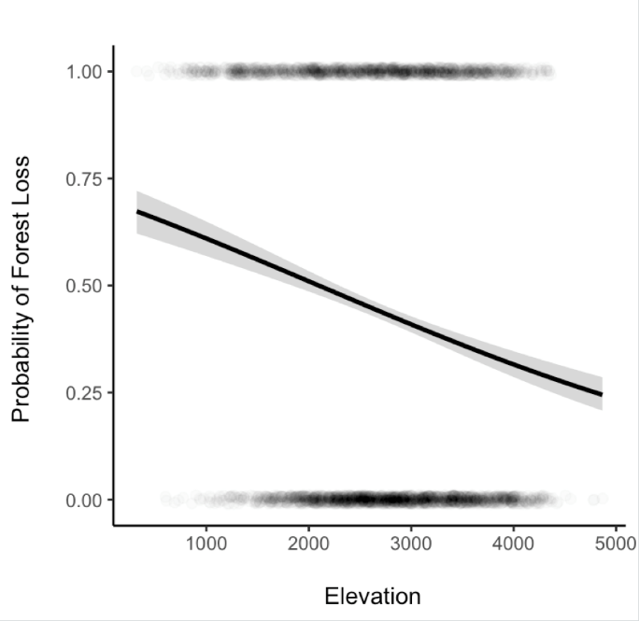
The probability of sampling a pixel with forest loss was three times higher at lower elevations compared to higher elevations
(Logistic regression, F-statistic = 80.532,
df = 3071, Adjusted R²= 0.025, p-value = <2e⁻¹⁶)

Slide 11
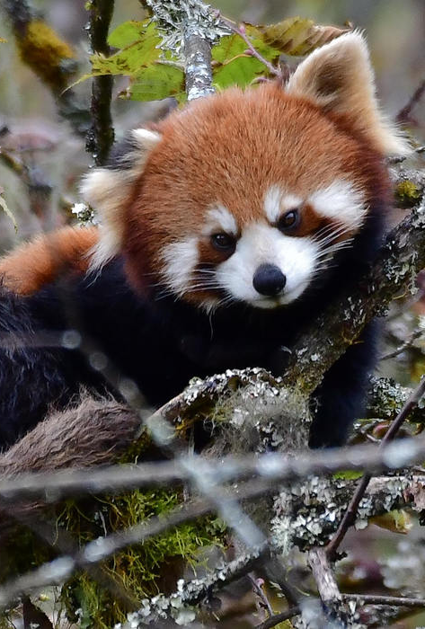
Conservation Implications
Potential forest connectivity throughout the range of each red panda sub-population.
Deforestation in forest corridors could potentially reduce connectivity, leading to genetic isolation.
High-altitude forests may be valuable places to focus protection to ensure connectivity throughout the red panda’s range
Photo credit: @pfaucher, iNaturalist
Notes:
pfaucher, iNaturalist

